Slide 1
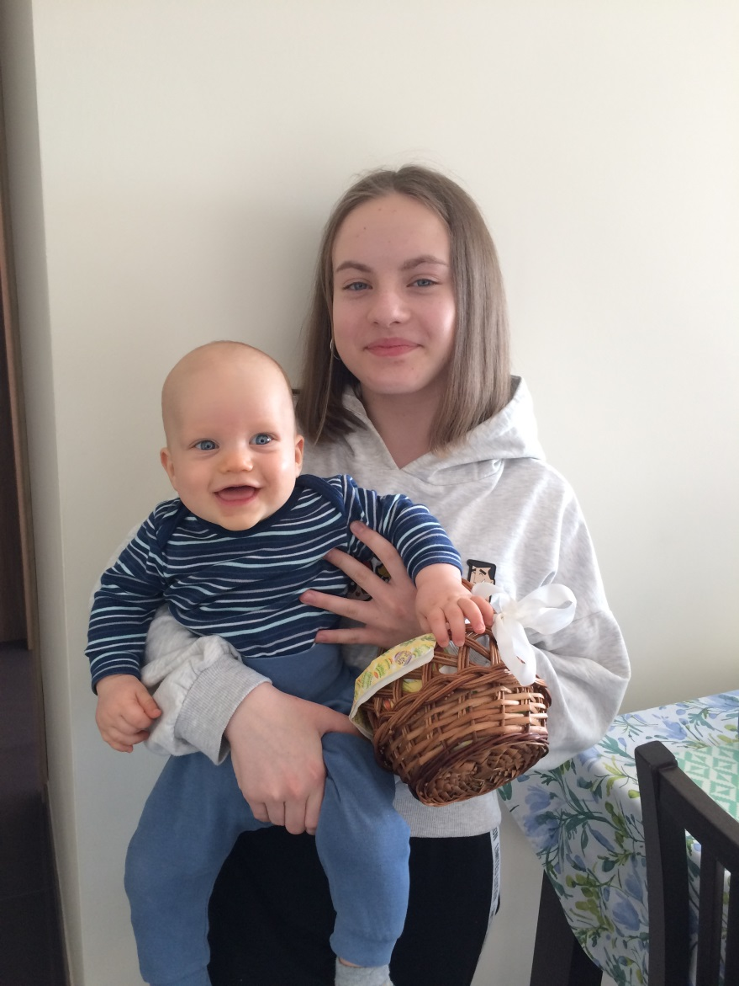
Easter

Slide 2
Cress- green symbol of Easter

Slide 3
Boxwood- symbol of world and nature

Slide 4
Easter palm - is a symbol of the Lord's Resurrection

Slide 5
Cross- redemption symbol

Slide 6
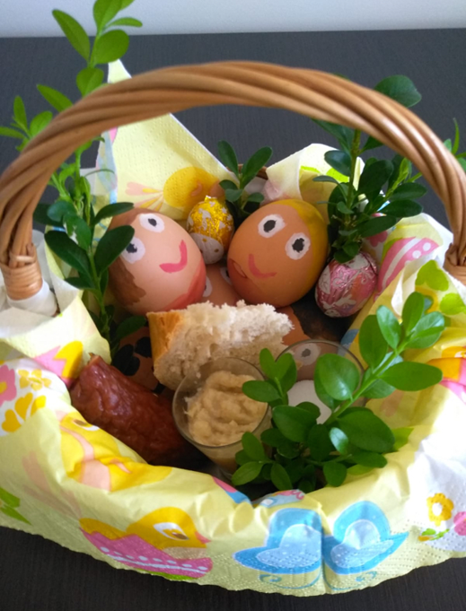
Easter basket
Bread- symbol of Christ's body
Egg- symbol of new life
Meat- symbol of health and fertility
Salt- symbol of purification, simplicity and truth
Lamb- symbol of Christ
Horseradish- symbol of human strength

Slide 7
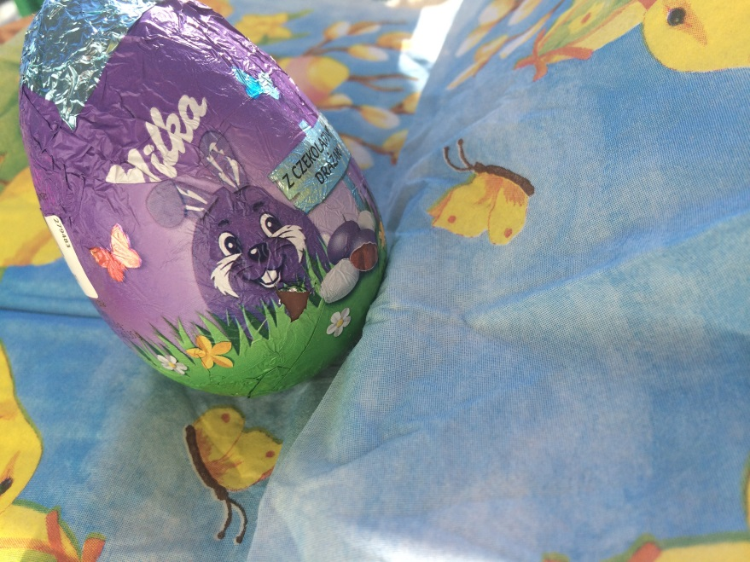
Easter eggs- symbol of new life

Slide 8
Chickling- symbol of new life

Slide 9
Lamb- symbol of Christ

Slide 10
Paschal candle- symbol of the resurrection of Christ

Slide 11
Cross- symbol of Resurrection of Christ

Slide 12
Easter breakfast

Slide 13
Hare- symbol of spring and life

Slide 14
Easter Monday is the day when people pour water

Slide 15
Easter Monday

Slide 16
Thank you for attention!
Paulina Skrobek

